Slide 1
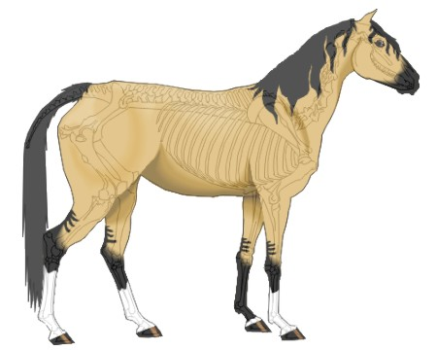
11.0 Describe Animal Health Needs
11.3 B Skeletal System

Slide 2
Bell Work
How does having an understanding of the skeletal system, help you in the maintenance and care of yourself and your SAE/livestock project?

Slide 3
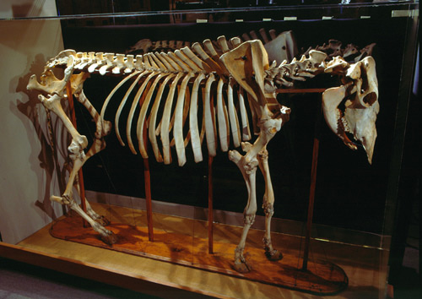
What is the function of bone?
Bone helps with:
  Movement
  Support
  Protection

Slide 4

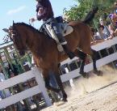
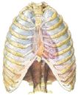
Function Of Skeletal System
Structural Support
Movement
Protection

Slide 5
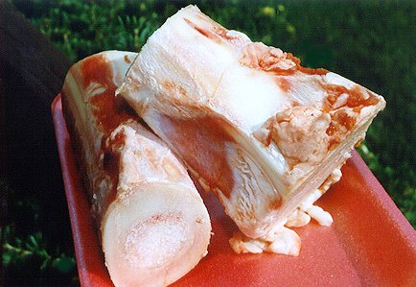
What is bone made of?
Bone is comprised of:
  26% minerals (mostly calcium phosphate and calcium carbonate)
  50% is water
  4% is fat
  20% is protein
  Bone requires adequate
  amounts of vitamins and
  minerals in the ration.

Slide 6
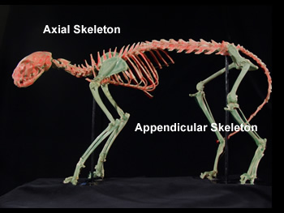
Important Terms Related to the Skeleton
Skeletons can be divided into two sections, which include
Axial Skeleton—These bones are on or close to the midline axis of the body and include the skull, vertebrae and ribs.
b. Appendicular skeleton—These bones project from the body in the pectoral (front) and pelvic (hind) limbs, and are connected to the body through the bones of the girdles.

Slide 7
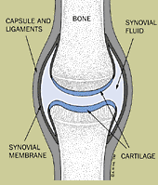
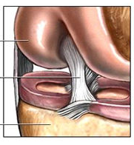
Other Skeletal Components
Joints—points where two or more bones meet.
Ligament—Tough band of connective tissue connecting one bone to another.

Slide 8
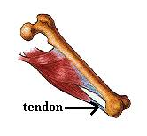
More Important Components
Tendon—Thick band of connective tissue that attaches muscle to bone.
Found at the end of a muscle.
Muscle contracts – it pulls on the tendon; which pulls the bone for movement.

Slide 9
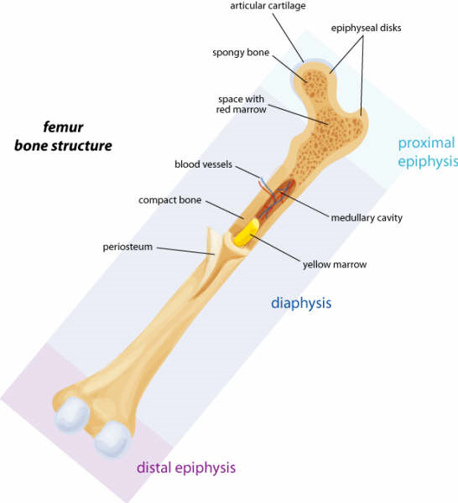
Compact Bone—layer of protective hard bone tissue surrounding every bone
Spongy Bone – Soft bone filled with many holes and spaces surrounded by hard bone.

Slide 10
Terminology | Definition | Picture/Function
Joints | Where two or more bones meet
Ligament | Band of connective tissue that attaches muscle to bone

Slide 11
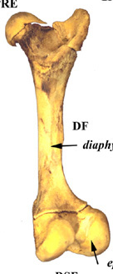
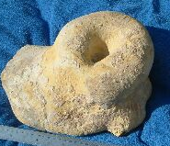
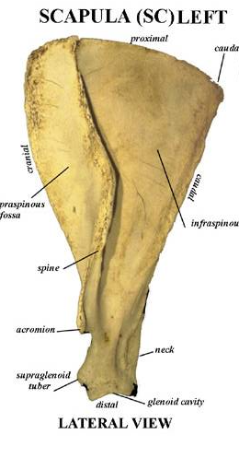
Types of bones in the animal body
Long Bones--They serve as support columns. They assist the animal in body support, locomotion and eating. Example: Femur
Short Bones--They are shaped like a cube and are located in complex joints, such as the knee and hock. They diffuse concussion and diminish friction. Example: Hock
Flat Bones--They protect vital
organs such as the brain, the
heart, and the lungs. They are longer
and wider than they are thick.
Example: Scapula

Slide 12
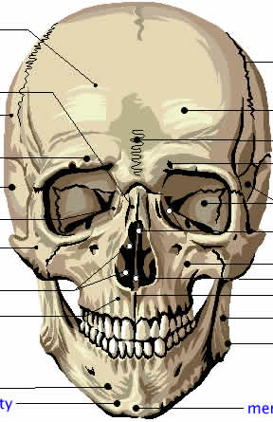
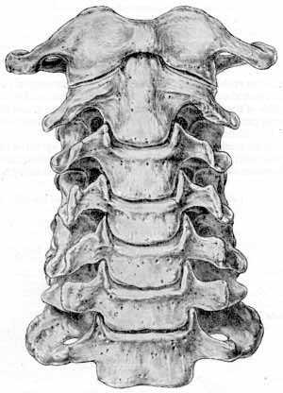
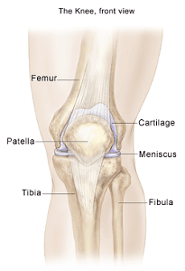
Types of bones in the animal body
Pneumatic bones--they contain air spaces called sinuses that are in contact with the atmosphere. Example: Frontal face bones.
Irregular Bones--important to the protection and support of the central nervous system and are points of some muscle attachment. Example: Vertebrae
Sesamoid Bones--they are flat and round. They are located along the course of tendons. Example: Kneecap or patella

Slide 13
Beginning of Class Activity
Please complete the horse skeleton diagram on the back of your note sheet.
You are responsible for completing your own but may work with the people at your table.
Horse skeleton diagrams may be found in the textbooks at the front of the class.
Check with Mr. Hartfield upon completion.

Slide 14

Activity!

Slide 15
Horses Skeleton
Stay in Your Groups!

Slide 16
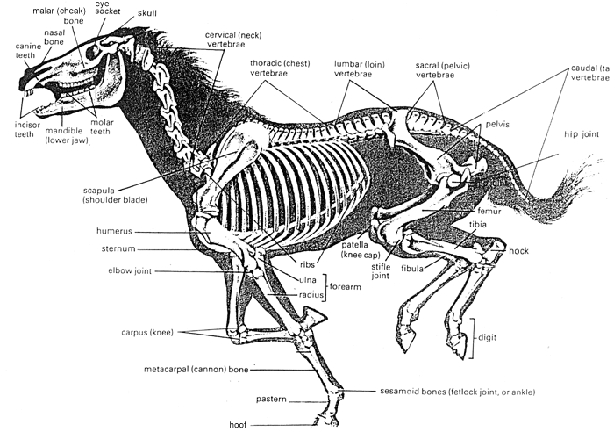
Unlabeled Horse Skeleton

Slide 18
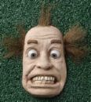
Let’s Summarize…
Don’t Forget Your
TICKET – Out!

Slide 19

GO BENSON BOBCATS!

